Slide 1
Second Draw PPP
Tony Chan
Executive Vice President/Chief Lending Officer

Slide 2
Founded in 2005
Headquarter in Rowland Heights
$1 billion asset size

Slide 3
Who is Eligible for Second Draw PPP?
Borrower has received First Draw PPP Loan
Borrower has used, or will use, the full amount of the First Draw PPP Loan before Second Draw PPP disbursement
300 or fewer employees
Experienced 25% revenue reduction during any quarter of 2020 compared to 2019 (i.e. $100,000 Gross Revenue in Q2 2019 and $50,000 Gross Revenue in Q2 2020)
20% or more of ownership must have TIN

Slide 4
China and Hong Kong Restriction
The Applicant is not a business concern or entity (a) for which an entity created in or organized under the laws of the People’s Republic of China or Special Administrative Region of Hong Kong, or that has significant operations in the People’s Republic of China or the Special Administrative Region of Hong Kong, owns or holds, directly or indirectly, not less than 20 percent of the economic interest of the business concern or entity, including as equity shares or a capital or profit interest in a limited liability company or partnership; or (b) that retains, as a member of the board of directors of the business concern, a person who is a resident of the People’s Republic of China.

Slide 5
Second Draw Terms
Loan Amount: 2.5 times monthly payroll
3.5 times monthly payment for restaurants and hotel/motels (NAICS 72…)
Maximum Second Draw Loan Amount: $2,000,000
1% interest rate
5 year maturity
Eligible for Full Loan Forgiveness!

Slide 6
Eligible Use of Funds
Payroll Costs (Must use 60% of PPP Loan for Full Forgiveness)
Rent
Mortgage Interest
Utilities
Covered Operations Expenditures
Covered Property Damage
Covered Supplier Costs
Covered Worker Protection Expenditures

Slide 7
Documents to Submit for PPP
PPP Application (2483 and 2483-SD), new versions as of 01/08/2021.
Payroll Records for 2019 or 2020
  Form 941s for all 4 Quarters
  Payroll Summary
  Evidence of any retirement, group health, life, disability, vision, dental insurance contributions paid by employer (if applicable)
  IRS Form 1065 K-1s for partnerships
For Second Draw PPP, evidence of 25% decrease in one quarter of 2020 vs. 2019
  Quarterly Financial Statements (if not audited, need to be signed and dated)
  Bank Statements
  Annual Tax Returns for 2019 and 2020

Slide 8
How to Calculate Monthly Payroll
Applicant may use 2019 or 2020 payroll
Add up all 4 quarters of Form 941 Gross Wages
Use Payroll Summary to Exclude Employees with Salary over $100,000
Add Employer Paid Payroll Costs (health insurance premium, retirement benefits, state/local taxes)
Take Total and Divide by 12 for Average Monthly Payroll
PPP Loan Amount is Average Monthly Payroll times 2.5 (or 3.5) is your PPP Loan Amount

Slide 9
Second Draw Application

Slide 10
Application Questions

Slide 11
Application Certifications

Slide 12
Application Certifications

Slide 13
Documents for Self-Employed
2019 or 2020 Form 1040 Schedule C (Personal Tax Return)
Form 1099-MISC, invoice, bank statement, or book of record, establishing self employment
2020 invoice, bank statement, or book of record on or around 2/15/2020
Maximum Loan Amount for Self-Employed with no Employees ($20,833)
If Self-Employed with Employees, also submit payroll documents

Slide 14
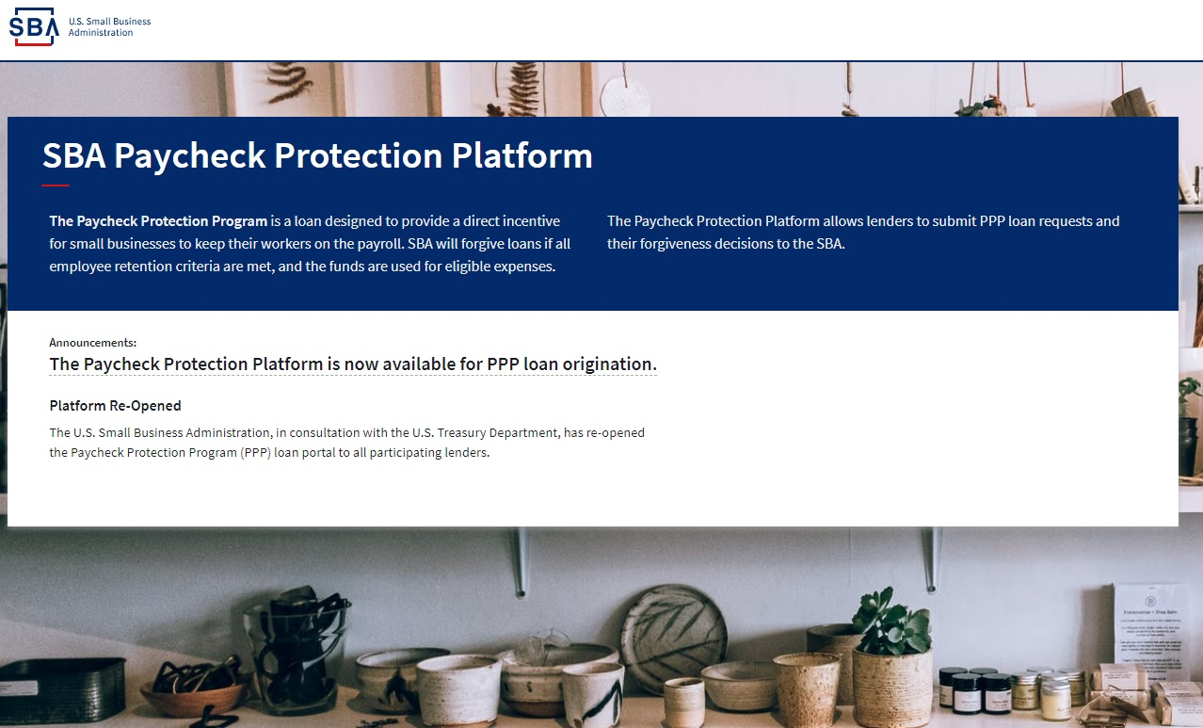
PPP Loan Submissions to SBA

Slide 15
PPP Loan Submissions to SBA
Different than previous PPP approval process
New PPP Loan Applications go directly to SBA for review and approval
Typical turnaround times for approval are 2-3 business days.
Lender will fund the loan within 10 days of approval.

Slide 16
Common PPP Application Errors

Slide 17
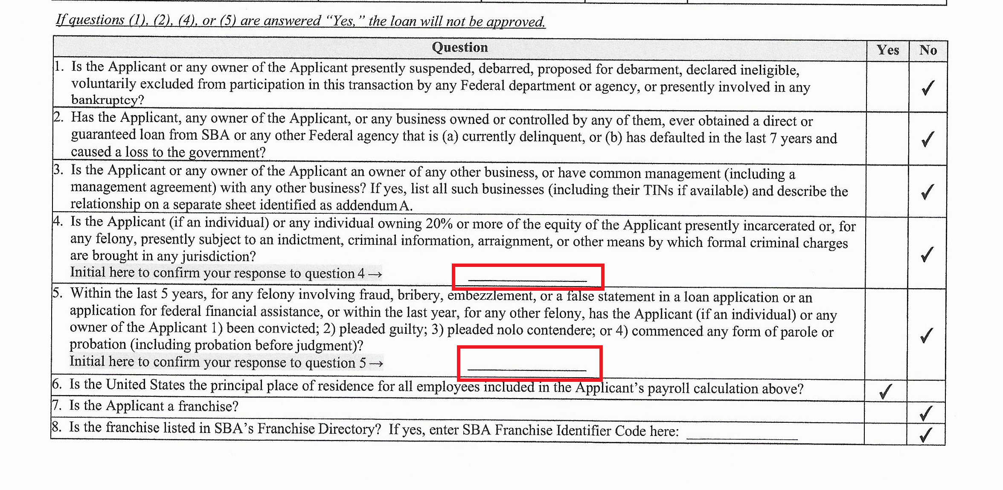

Slide 18
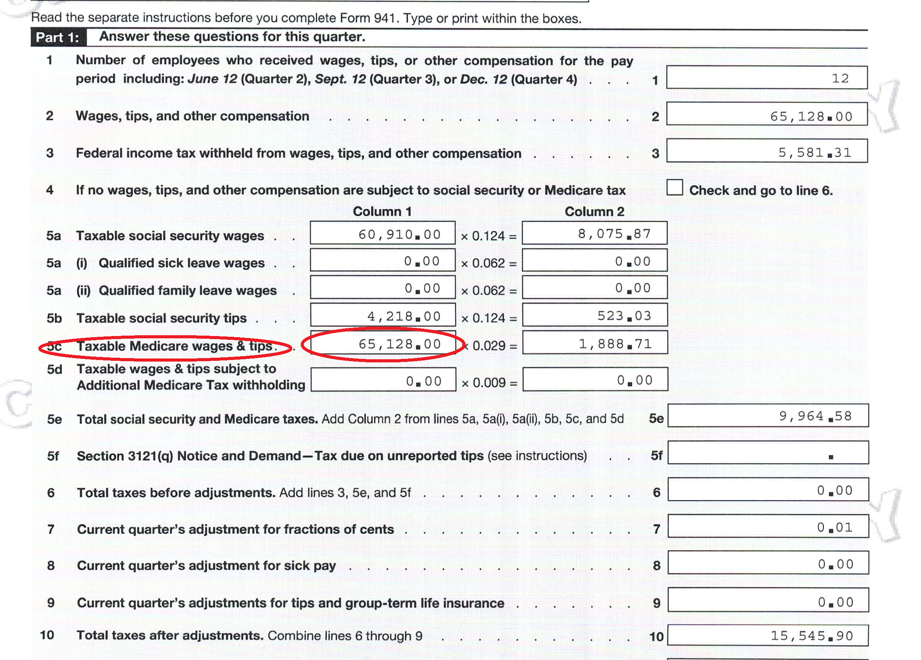

Slide 19
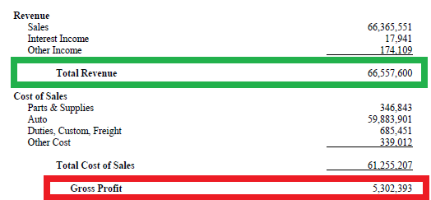

Slide 20
PPP Loan Forgiveness

Slide 21
Forgiveness Rules
Must spend 60% of PPP Loan on Payroll Costs
Can use other 40% on non-payroll eligible expenses (mortgage interest, rent, utilities, etc.)
Salary and Wages eligible for forgiveness may not exceed an annual salary of $100,000, prorated for the Covered Period.
  8-week Covered Period, Maximum Salary eligible for forgiveness is $15,385 ($100,000 / 52 weeks x 8 weeks = $15,385)
  24-week Covered Period, Maximum Salary eligible for forgiveness is $46,154 ($100,000 / 52 weeks x 24 weeks = $46,154)
Owner-employee, self-employed or general partners
  Forgiveness Cap is $20,833 (2.5 months of $100,000) or 2.5 times Owner Compensation during 2019/2020, whichever is lower

Slide 22
PPP Forgiveness Application
Three Versions of the PPP Forgiveness Application
  3508S – Simplified Application for $150,000 or less
  3508EZ – Can use if:
    Borrower did not reduce salary or hourly wages by more than 25% AND did not reduce number of employees
    Borrower did no reduce salary or hourly wages by more than 25% AND was not able to operate during covered period at the same level of business activity as before 2/15/2020 due to COVID-19
  3508 – Borrower not qualified to use EZ form

Slide 23
What Documents to Submit?
PPP Forgiveness Application (3508-S or 3508EZ or 3508)
Payroll Costs
  Third-Party Payroll Summary or Bank Statements for Covered Period
  Payroll Tax Filing Reports (Form 941 and DE-9)
  Payment Receipts for Employer Contributions for insurance and retirement plans
Non-Payroll Costs
  Mortgage Interest – Mortgage Statement before Feb 2020 and Proof of Payment
  Rent – Lease Agreement from before Feb 2020 and Proof of Payment
  Utilities – Utility Bill from Feb 2020 and Proof of Payment

Slide 24
Covered Period
Period of time to use PPP Funds to be eligible for Full Forgiveness
Covered Period Starts on the loan disbursement date
Covered Period Ends on a date selected by the Borrower that is between 8 weeks to 24 weeks after loan disbursement.

Slide 25
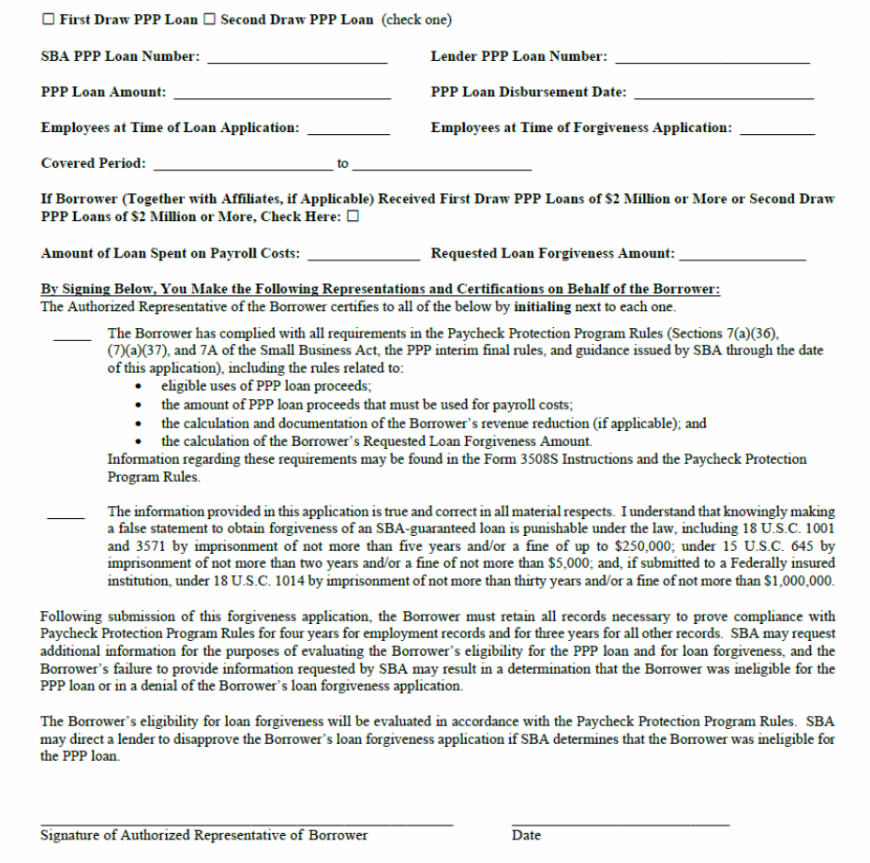

Slide 28
SBA 7(a) Loan Changes

Slide 29
SBA 7(a) Loan Program Highlights
Maximum Loan Amount up to $5,000,000
Maximum LTV up to 85%
25 year Fully Amortized Loan (Real Estate)
  Prepayment Penalty: 5% (Year 1), 3% (Year 2), 1% (Year 3)
10 years Fully Amortized Loan (Working Capital, Equipment or Inventory)
Guaranty Fee paid to SBA – approximately 3.0 - 3.5% (currently waived!)
No Bank Origination Fee (Points), Only Flat Packaging Fee (up to $2,500)
Prime based Floating Rate, Adjusted Quarterly
Owners over 20% will need to provide Personal Guaranty
Source of Down Payment needs to be Verified

Slide 30
Eligible Real Property Types
Hotel/Motels
Owner-Occupied Industrial Warehouse
Owner-Occupied Office Building
Medical Facilities
Restaurant Building
Other Special Purpose Properties:
  Gas Station, Car Wash, Laundromat, Self Storage, etc.

Slide 31
Economic Aid Act Changes
Waiver of the SBA Guaranty Fee
  Guaranty Fee on a $5,000,000 SBA 7(a) loan is $138,125.
  This Fee is now waived due to Economic Aid Act
3 months of loan payment covered by SBA (up to $9,000/month)
  If loan payment is less than $9,000 a month, there will be no payments due by Borrower for 3 months.
  If loan payment is greater than $9,000 a month, Borrower is responsible for the portion above $9,000. (i.e. $15,000 loan payment - $9,000 = $6,000 reduced payment)
Changes effective until 9/30/2021 or until funds are depleted

